Slide 1

Obstacle Detection using Arduino
Department of Computer Science and Engineering
Graphic Era (Deemed to be University)
Dehradun, Uttarakhand
January 2023
Submitted by: University Roll No.
KUMKUM 2019676
Under the Mentorship of
Dr. UPMA JAIN
Assistant Professor

Slide 2
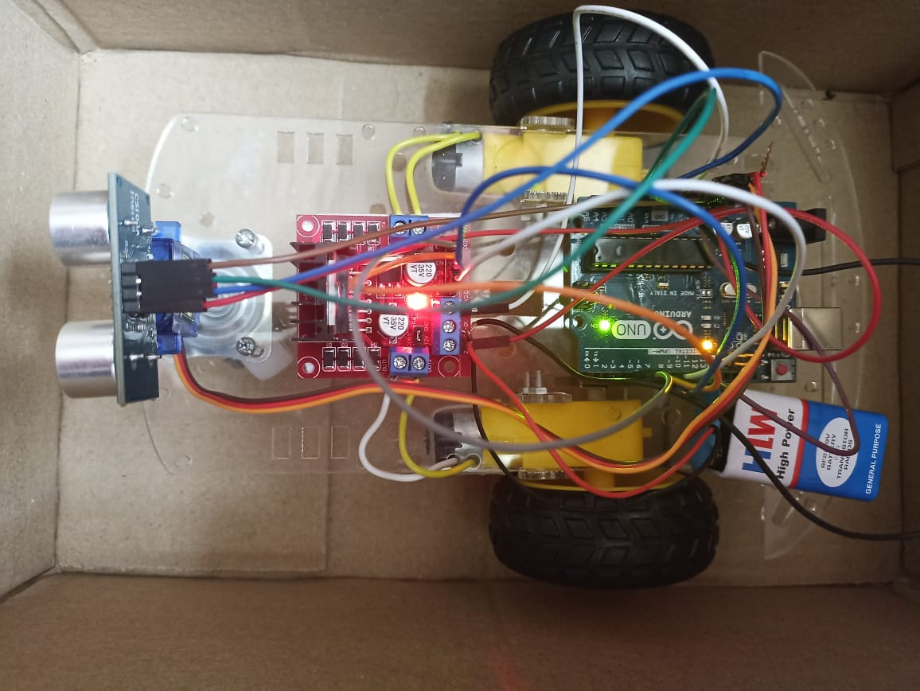
Introduction
Obstacle avoidance means to be able to identify and detect any kind of interference, which can also be termed as obstacles, and either avoid crashes into it or even selects its path around it. Such a project would be very helpful in helping robots in factories and even in day to day house chores. Our project uses ultrasonic sensors in support with Arduino Uno development board. It works on a very simple principle. An ultrasonic sensor has a source and an echo receiver. It sends bursts of ultrasonic signals and the echo receiver receives it and determines how far or how close any object reflecting the signals is in front of it. It is controlled by an Arduino Uno board, which is programmed to control the motors in the car, to stop or proceed as per information received by the sensor.

Slide 3
Methodology
S.NO | COMPONENTS USED | QUANTITY
1. | Arduino Uno | 1
2. | 24V DC Motors | 2
3. | Ultrasonic sensors | 1
4. | Motor Driver(L2893N) | 1
5. | Wheels | 2
6. | Power Source for Arduino and Motors | _
7. | Servo Motor | 1

Slide 4
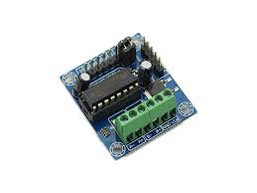
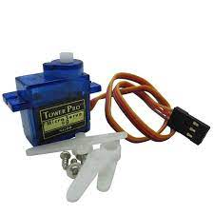
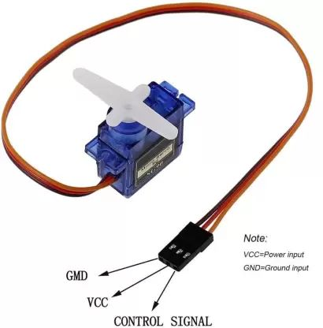
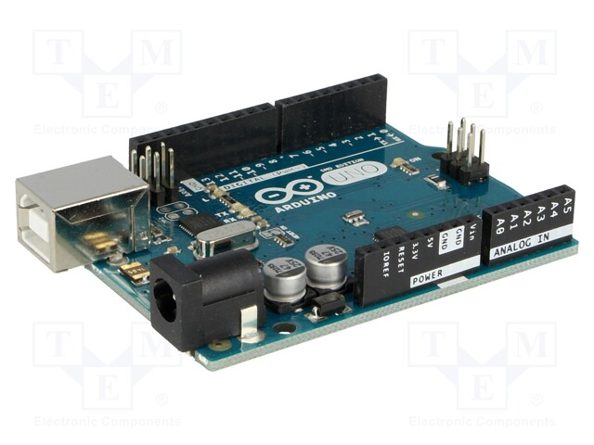
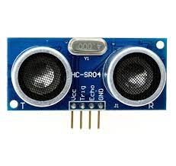
Component used
ARDUINO UNO
ULTRASONIC SENSOR
L2893N MOTOR DRIVER
SERVO MOTOR

Slide 5
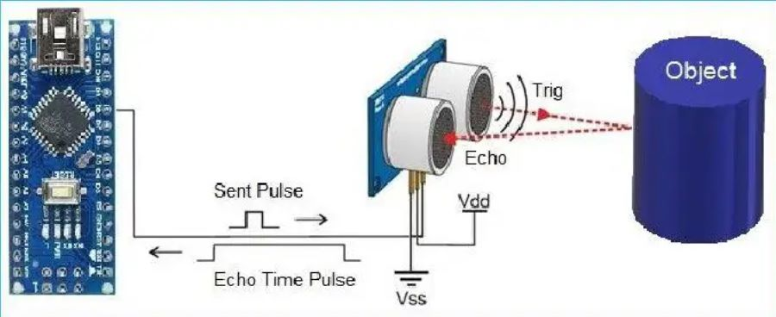
Working 1. The car is switched on by giving it 12V DC power from an external battery. The motors starts rotating and thus the car starts moving forward. 2. During this time, the ultrasonic sensors continuously keep calculating the distance between the car and the reflective surface. 3. This information gets processed by the ARDUINO. 4. If the distance between the car and the obstacle is less than the specified value, the car changes its path(moves towards the back).Here, we have kept the minimum distance to be of 20cm. 5. This process continues forever and the car keeps moving without danger.

Slide 6
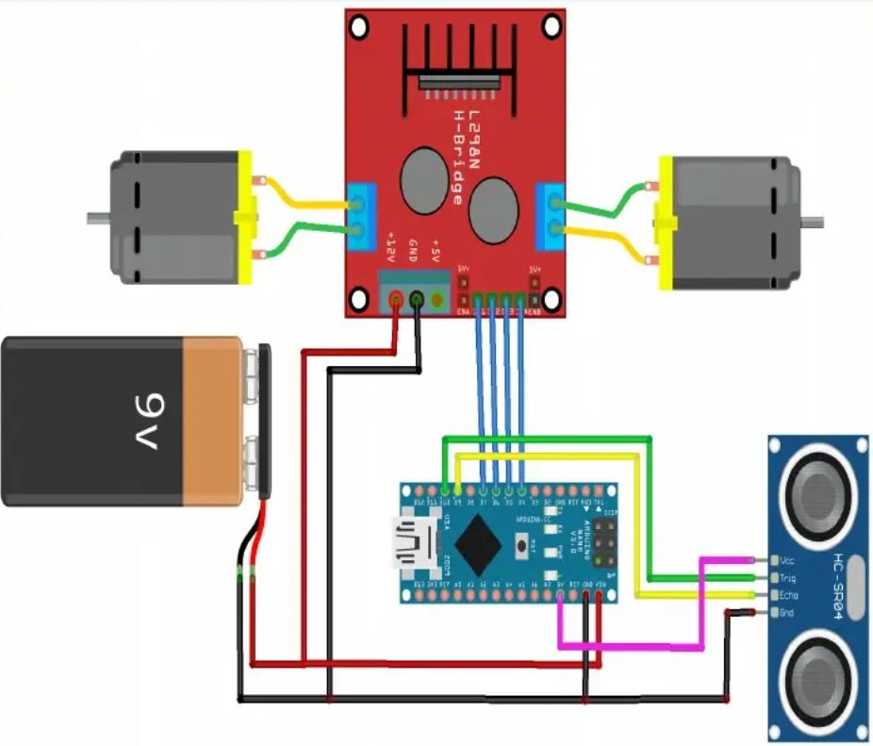
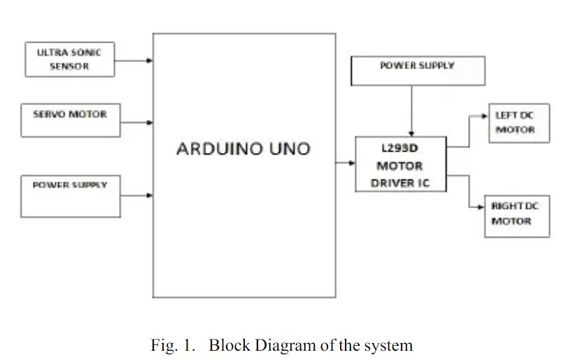
Block Diagram
Component Arrangement

Slide 7
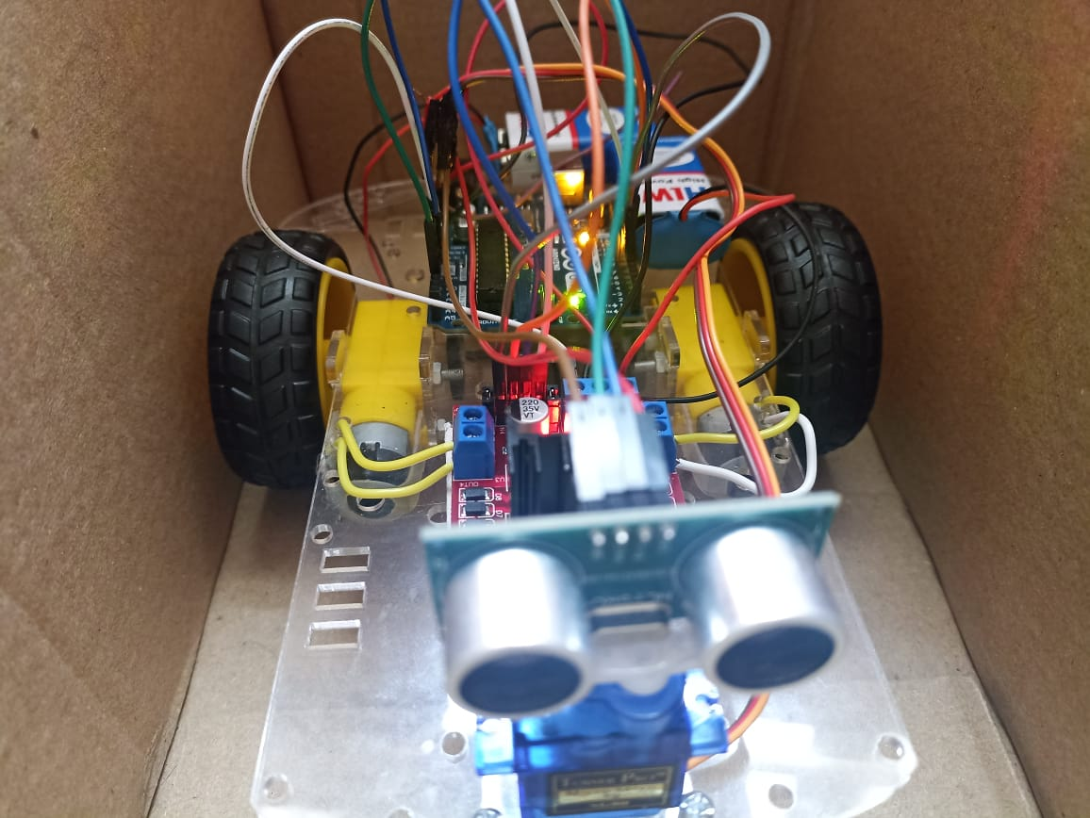
Glimpse of the car

Slide 8

Demonstration of the Project

Slide 9
Result and Discussion
The result is obtained for obstacle avoidance car using Arduino, if the car moves forward if any obstacle detect it check for other directions and moves where there is no obstacles it moves in forward direction, to sense the obstacle ultrasonic sensor is used. We used servo motor to rotate the ultrasonic sensor.
With the use of an ultrasonic sensor, the barrier-avoiding car can identify obstructions such as obstacles and barriers and alter its course to get around them. The servo motor aids in giving the robot a larger field of view.

Slide 10
Conclusion and Future Work
This project developed an obstacle avoiding car to detect and avoid obstacles in its path. The car is built on the Arduino platform for data processing and its software counter part helped to communicate with the car to send parameters for guiding movement. For obstacle detection ,one ultrasonic sensor was used and a servo motor provided a wider field of detection. The car is fully autonomous and after the initial loading of the code, it requires no user intervention during its operation. When placed in unknown environment with obstacles, car uses ultrasonic sensor to calculate the distance and detect the obstacles around it and is also capable of taking it’s own decisions regarding changing the directions to make a movement. The vehicle routes itself with the help of input from the ultrasonic sensor. The input from the ultrasonic sensor is passed to arduino where it is processed and then the commands by the arduino are passed to the motors. In this way the car operates and takes decisions to move in any of the directions. In order to optimize the movement of the car, we have many considerations for improvement. However, most of these ideas will cost more money and time as well. In future, cameras can be used to detect the obstacle.

Slide 11
This model was a very basic one, saving both time and money, and clearly demonstrates the idea we had. For better and more accurate results, preferable three ultrasonic sensors can be used for a wider field of view, to cover a greater region.Also, otherwise it can be fitted with camera modules and AI can be implemented so that it can be used in real life applications, like on roads, judging other vehicles speed, speed breakers, traffic light signals and even change lanes, which is same as the technology used in currently some of the most advanced autonomous driving robots made by tech giants. Further for military uses, it can be fixed with a GSM Module or a Radio Module and be provided with a manual control, for even better maneuvers. We can conclude that this project of ours has a vast scope in future applications

Slide 12
Thank You !

